Slide 1
Sound Waves

Slide 2
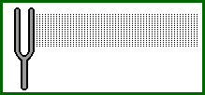
The Nature of Sound
Sound Waves
  Created by a vibrating object such as the string on a violin, your vocal chords or the diaphragm of a loudspeaker.
  Sound waves can be transmitted through gases, liquids and solids.
  If there is no medium, there is no sound.
Notes:
Vibration causes cyclical vibrations of the molecules in the medium.
Demo – Bell Jar

Slide 3
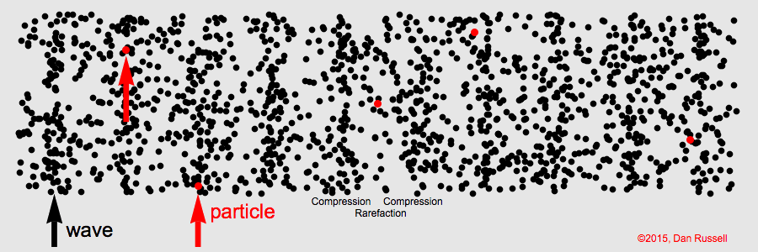
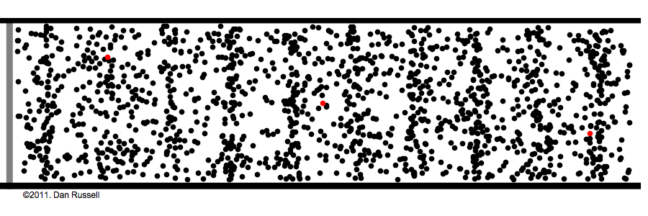
How is Sound Transmitted?
Sound is created by the cyclical collisions of atoms and molecules such that it is transmitted through the bulk matter.

Slide 4
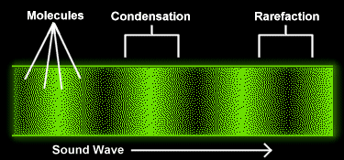
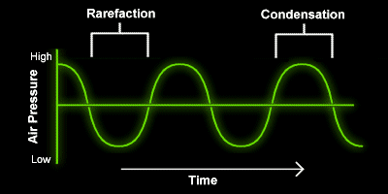

Sound Wave Characteristics
Condensation or Compression: Region of the wave where air pressure is slightly higher.
Rarefaction: Region of the air wave where the pressure is slightly lower.
Pure Tone: A sound wave with a single frequency.
Pitch: An objective property of sound associated with frequency.
  High frequency = high pitch.
  Low frequency = low pitch.
Loudness or Volume: The attribute of sound that is associated with the amplitude of the wave (Energy).
Beats: When two sound waves overlap with a slightly different frequency.
  1 Hz beat frequency
  2 Hz beat frequency
www.library.thinkquest.org
Notes:
Sound Boxes.

Slide 5

Speed of Sound
Speed of sound depends on the medium through which it travels.
Where:
k = Boltzman’s constant (1.38 x 10⁻²³ J/K)
γ = C_{p}/C_{v} (~5/3 for ideal monotonic gases)
T = Temperature (K)
m = Average mass of air (~28.9 amu)
 | Air | Water | Steel
Speed (m/s) | 343 | 1482 | 5960
$v_{rms}$ = $\sqrt{\frac{γkT}{m}}$

Slide 6

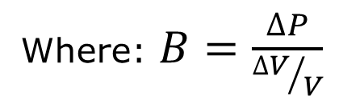
Speed of Sound – An Alternative View
The speed of sound in other mediums may also be represented by a mathematical relationship that includes the density (ρ) and the bulk modulus (B)
Gases have a lower bulk modulus than liquids and liquids have a lower bulk modulus than solids.
  Hence, as the bulk modulus increases, the velocity increases.
$$v =\sqrt{\frac{B}{ρ}}$$
Where: $B=\frac{∆P}{{∆V}/V}$

Slide 7
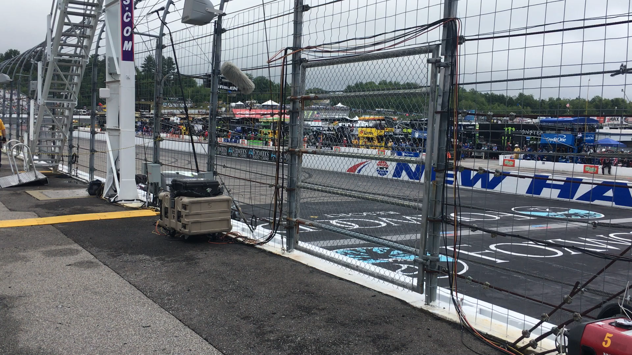
The Doppler Effect
Notes:
This and the following slides are tools from the Doppler Effect tutorial.

Slide 8
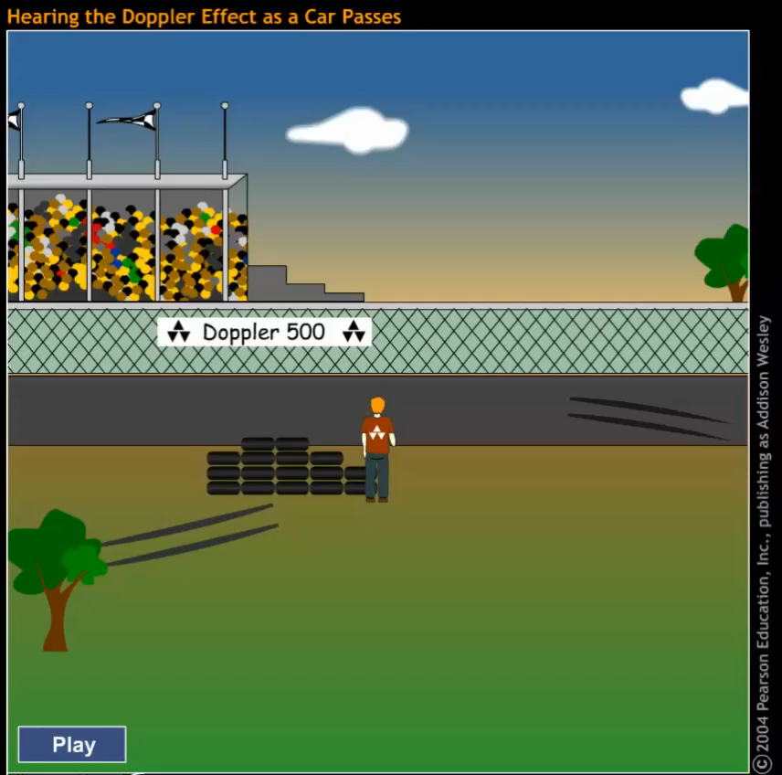
The Doppler Effect
Notes:
This and the following slides are tools from the Doppler Effect tutorial.

Slide 9
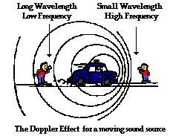
Doppler Shift
The change in sound frequency due to the relative motion of either the source or the detector.
Low Pitched Sound
High Pitched Sound
www.physicsclassroom.com
Note: Even though the vehicle is in motion, the speed of sound is the same for all observers.

Slide 10
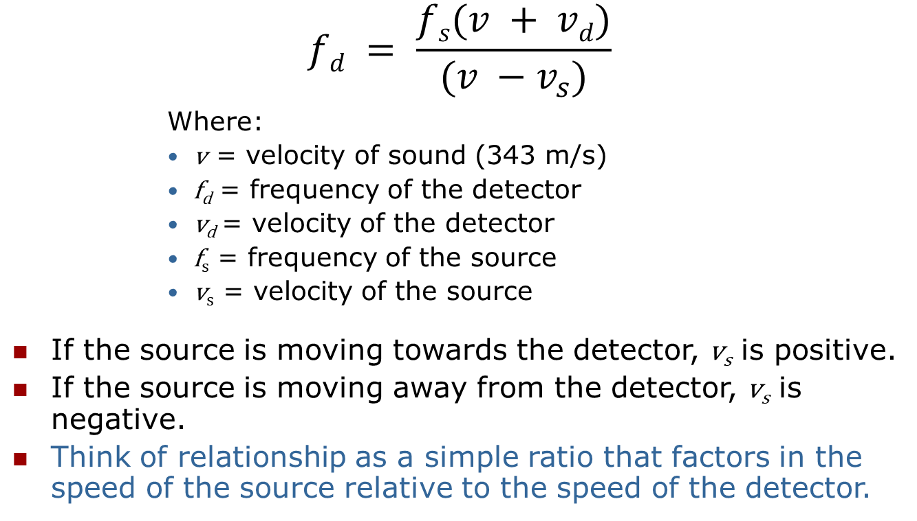
Doppler Shift
$$fd = \frac{fs(v + vd)}{(v −v_{s})}$$
      Where:
      v = velocity of sound (343 m/s)
      f_{d} = frequency of the detector
      v_{d} = velocity of the detector
      f_{s} = frequency of the source
      v_{s} = velocity of the source
If the source is moving towards the detector, v_{s} is positive.
If the source is moving away from the detector, v_{s} is negative.
Think of relationship as a simple ratio that factors in the speed of the source relative to the speed of the detector.

Slide 11
What You Already Know
Principle of Linear Superposition (Interference)
  When two or more waves are present at the same point in space and time, the resultant disturbance is the sum total of each of the individual disturbances.
Constructive Interference (Standing Waves)
  Constructive interference will occur when two wave sources vibrate in phase such that the difference in path lengths is zero or an integer # of wavelengths.
Destructive Interference (Standing Waves)
  Destructive interference occurs when two wave sources vibrate in phase such that the difference in path lengths that is ½ or a half-integer # of wavelengths.
Notes:
Singing rods with rosin.

Slide 12
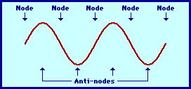
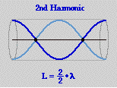
Standing Waves in Musical Instruments
Resonance: Stringed instruments, such as the guitar, piano or violin, and horn and wind instruments such as the trumpet, oboe, flute and clarinet all form standing waves when a note is being played.
  The standing waves are of either the type that are found on a string, or in an air column (open or closed).
  These standing waves all occur at natural frequencies, also known as resonant frequencies, associated with the instrument.

Slide 13
Standing Wave Characteristics
While a standing wave does not travel itself, it is comprised of two waves traveling in opposite directions.
  Harmonic: The series of frequencies where standing waves recur (1f, 2f, 3f,…). Where the first frequency is called the first harmonic (1f), the second frequency is called the second harmonic (2f), and so on.
  The first harmonic = the first fundamental frequency (n = 1).
  Overtones: The harmonic frequency + 1.

Slide 14
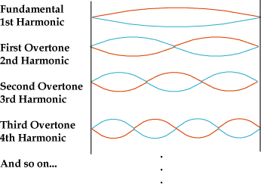
Harmonics and Overtones of Standing Waves on a String
www.cnx.rice.edu

Slide 15
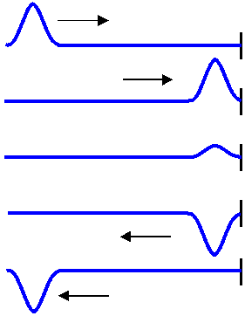
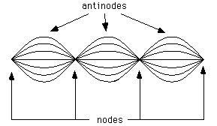
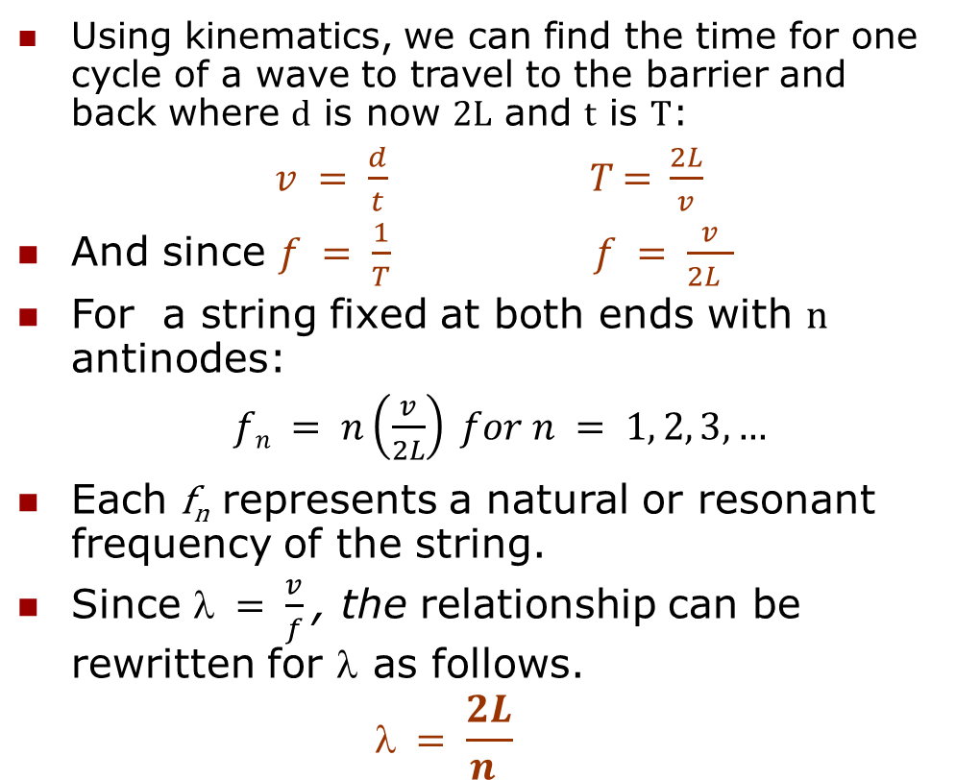
Standing Wave Characteristics on a String (cont.)
Using kinematics, we can find the time for one cycle of a wave to travel to the barrier and back where d is now 2L and t is T:
$v = \frac{d}{t}$ 𝑇 = $\frac{2L}{v}$
And since $f = \frac{1}{T}$ $f = \frac{v}{2L }$
For a string fixed at both ends with n antinodes:
      $fn = n\left(\frac{v}{2L}\right) for n = 1, 2, 3, …$
Each f_{n} represents a natural or resonant frequency of the string.
Since $ = \frac{v}{f}$, the relationship can be rewritten for λ as follows.
  $$ = \frac{2L}{n }$$
L
www.electron4.phys.utk.edu
www.cord.edu

Slide 16
Longitudinal Standing Waves (Columns of Air)
Wind instruments, such as the flute, oboe, clarinet, trumpet, etc. develop longitudinal standing waves.
  They are a column of air.
  May be open at one or both ends.
  The wave will reflect back regardless as to whether or not it is open or closed.
Longitudinal Standing Waves

Slide 17
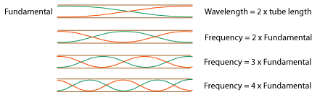
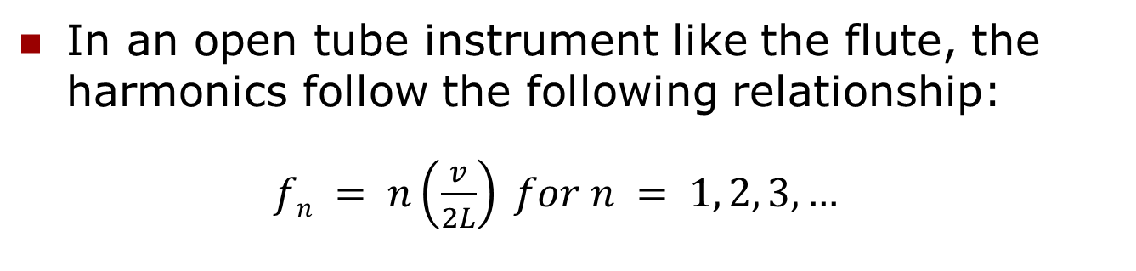
Longitudinal Standing Waves – Open Tube
In an open tube instrument like the flute, the harmonics follow the following relationship:
$fn = n\left(\frac{v}{2L}\right) for n = 1, 2, 3, …$
www.cnx.rice.edu

Slide 18
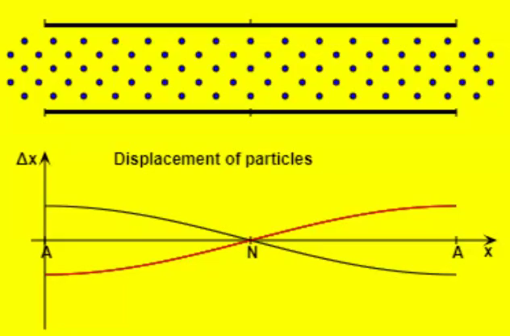
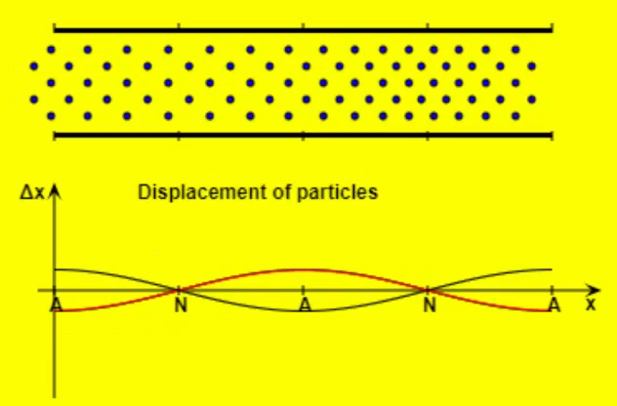


Longitudinal Standing Waves
Tube Open at Both Ends:
1st Harmonic/Fundamental
2nd Harmonic/1st Overtone
$$n=1$$
$$n=2$$

Slide 19
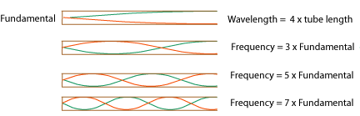

Longitudinal Standing Waves –Tube Closed on One End
In a closed tube instrument like the clarinet or oboe, the harmonics follow the following relationship:
$fn = n\left(\frac{v}{4L}\right) for n = 1, 3, 5, …$
www.cnx.rice.edu

Slide 20
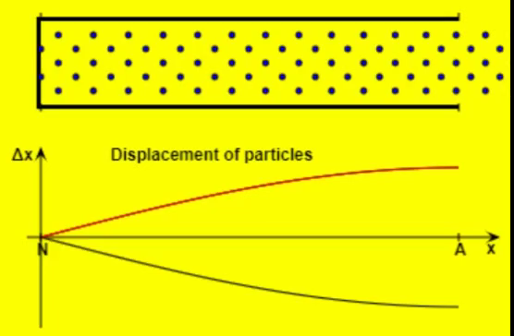
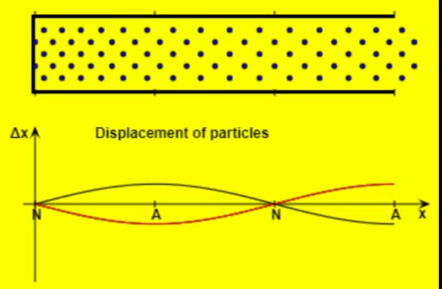


Longitudinal Standing Waves
Tube Closed at one end (like lab):
1st Harmonic/Fundamental
3rd Harmonic/1st Overtone
$$n=1$$
$$n=3$$

Slide 21
Key Ideas
Sound waves are generated by a vibrating object such as the string on a violin, your vocal chords or the diaphragm of a loudspeaker.
Sound waves can be transmitted through gases, liquids and solids.
If there is no medium, there is no sound.
Sound is generated by the cyclical collisions of atoms and molecules.
Condensation and rarefaction denote portions of the wave that are of slightly higher and lower pressure, respectively.

Slide 22
Key Ideas
Sound waves travel at different speeds in different mediums.
  They speed up when going from air to a liquid to a solid.
Pure tone is sound of a single frequency.
Pitch and loudness are characteristics of sound that represent its frequency and amplitude, respectively.
When two sound waves overlap slightly due to mildly different frequencies, they generate a beat.
Harmonics occur at multiples of the natural frequency.

